Slide 1



EINBÜRGERUNGSTEST - GERMAN CITIZENSHIP TEST
33

Slide 2
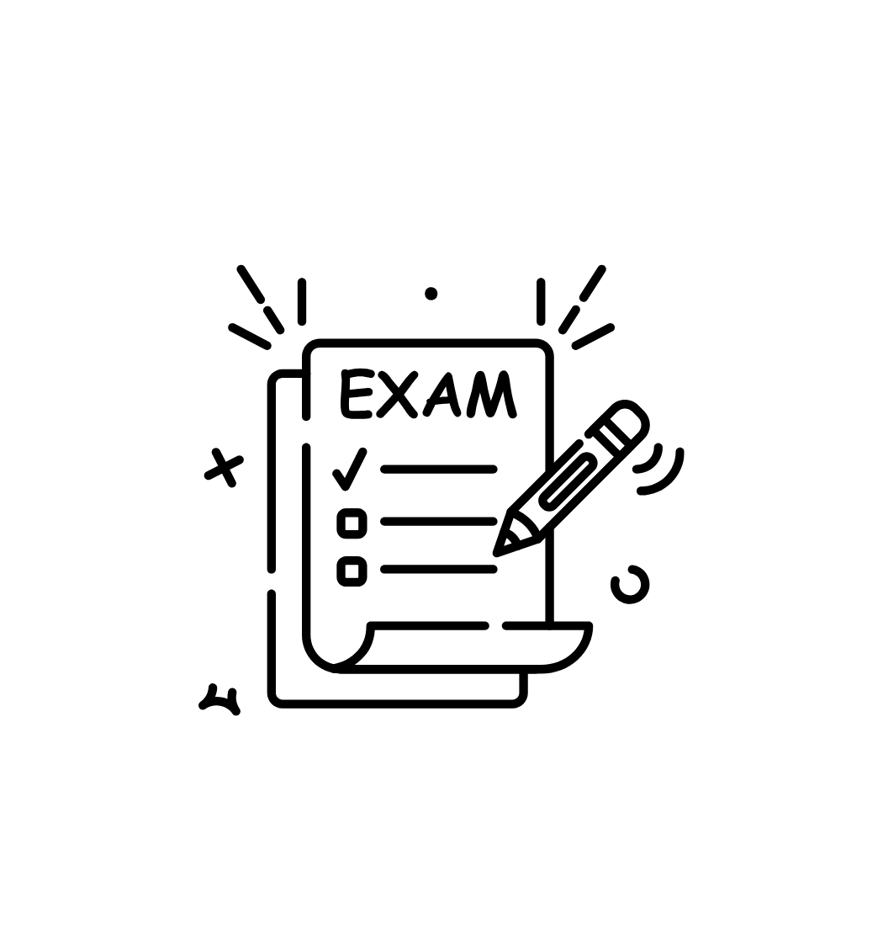



What is “Leben in Deutschland” Test?
LiD is the standardized orientation-course test covering knowledge of Germany's legal and social order and everyday life.
Orientation Course
Citizenship Knowledge
Same Question World
The LiD test is taken at the end of the orientation course.
With at least 17/33 correct, LiD can provide the required knowledge certificate for naturalization.
The LiD and Einbürgerungstest use the same official catalogue of 310 questions.
German civic knowledge + everyday life + history + society + democracy
Not just memorizing answers — understanding what the questions are asking.
Leben in Deutschland • Introductory Series
ranjigt.github.io/lid-trainer
02

Slide 3


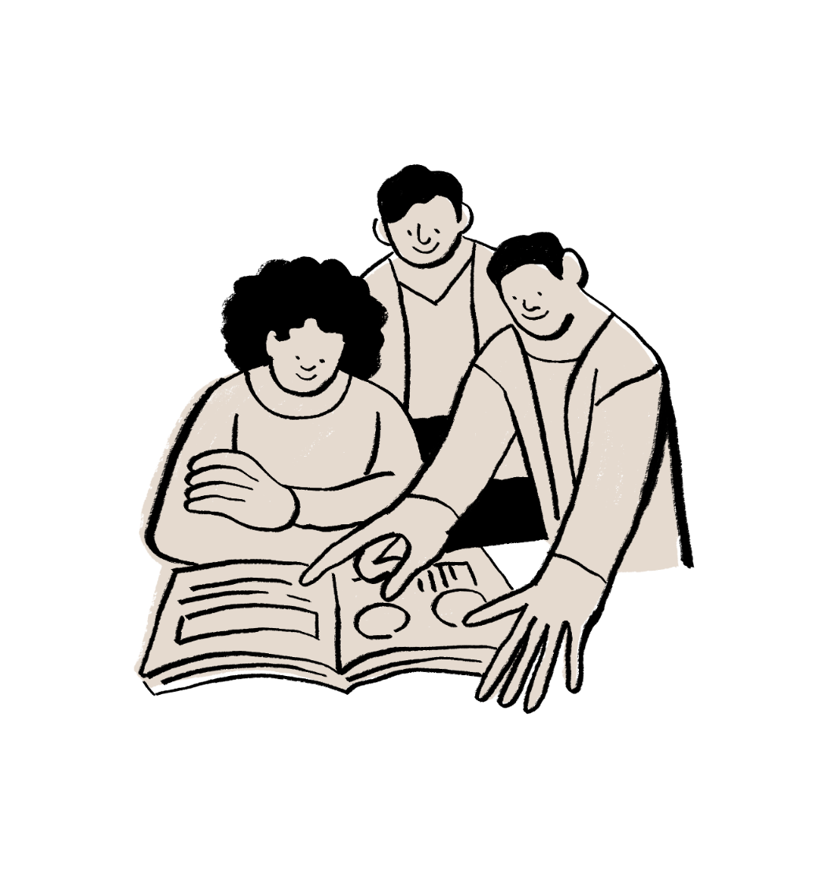

Who takes the Test?
The audience is broader than people applying for citizenship tomorrow.
Newcomers in Germany
Citizenship/PR applicants
People completing an integration / orientation course.
People who need proof of knowledge for naturalisation.
Repeat Learners
Self-learners
People who want another attempt or more confidence.
Anyone who wants to understand Germany's society, rights and history.
The goal of this series: make preparation structured, visual and less intimidating.
03
Leben in Deutschland • Introductory Series
ranjigt.github.io/lid-trainer

Slide 4




Who conducts the Test?
The Federal Office for Migration and Refugees (Bundesamt für Migration und Flüchtlinge - BAMF) is the official authority in Germany responsible for the Einbügerungstest (German Citizenship test).
Volkshochschulen (VHS)
Local community adult education centers.
German Embassies or Consulates
Licensed Language Schools
Administered at your local diplomatic mission in co-operation with BAMF.
Private schools or centers accredited by BAMF.
The goal of this series: make preparation structured, visual and less intimidating.
A nationwide standardized fee of 25 EUR
Leben in Deutschland • Introductory Series
ranjigt.github.io/lid-trainer
04

Slide 5
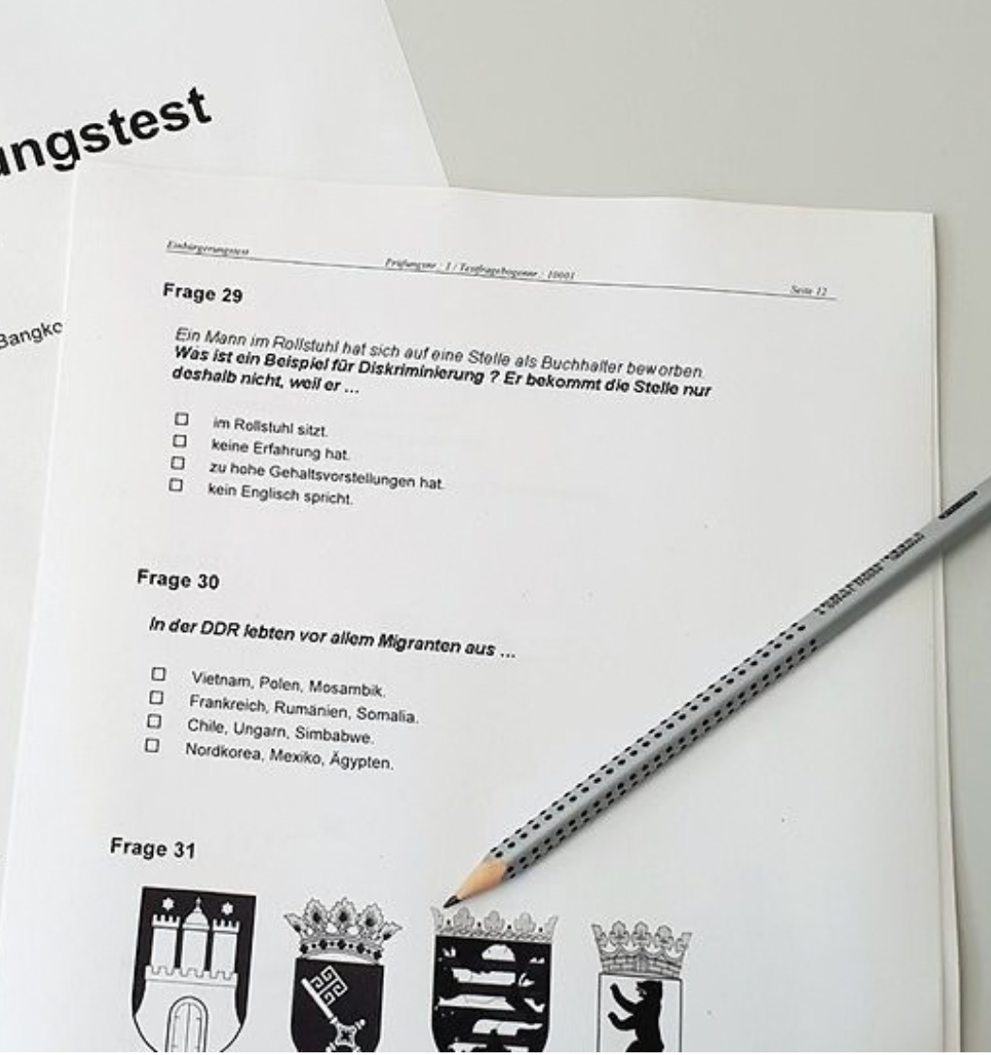
What does the test look like?
33 questions
310
One correct answer per question
60 minutes
official preparation
questions
Plenty of time if you know the material
300
17 / 33
general questions
Knowledge threshold relevant to naturalisation
+ 10
state-specific
Leben in Deutschland • Introductory Series
ranjigt.github.io/lid-trainer
05

Slide 6




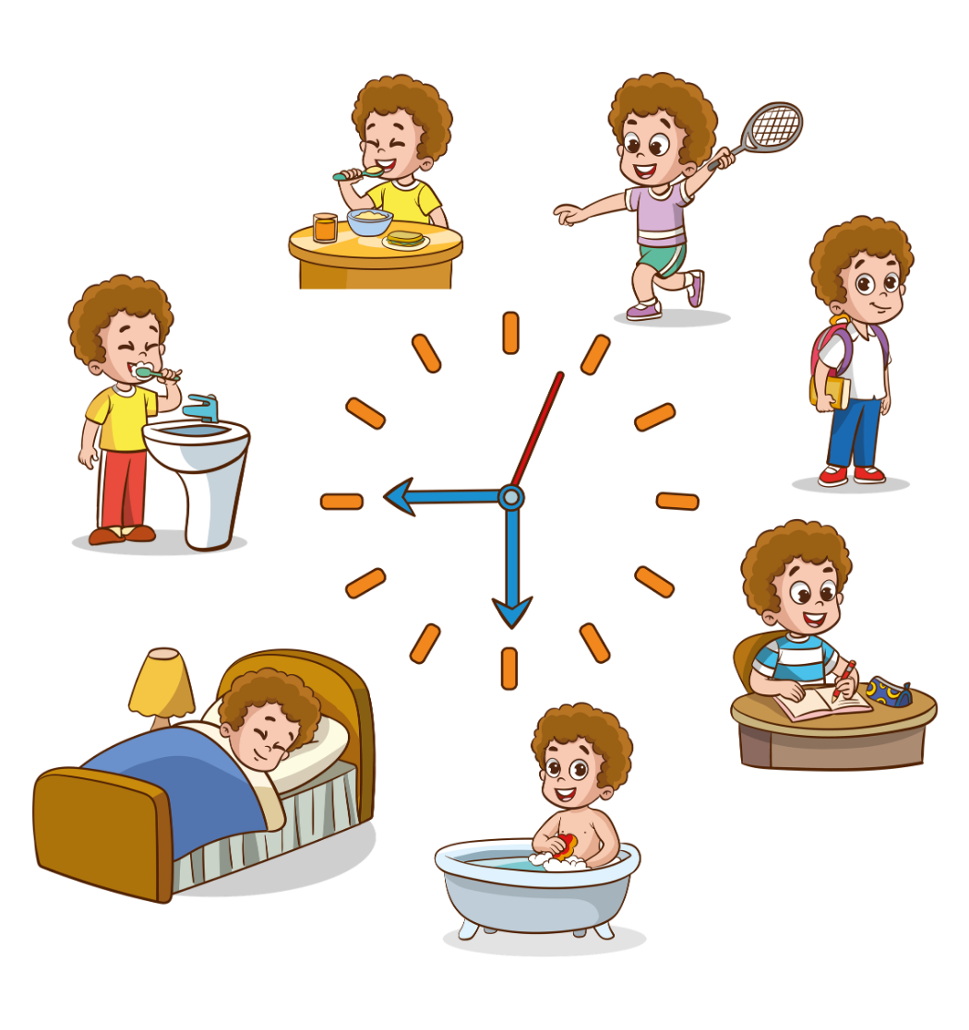
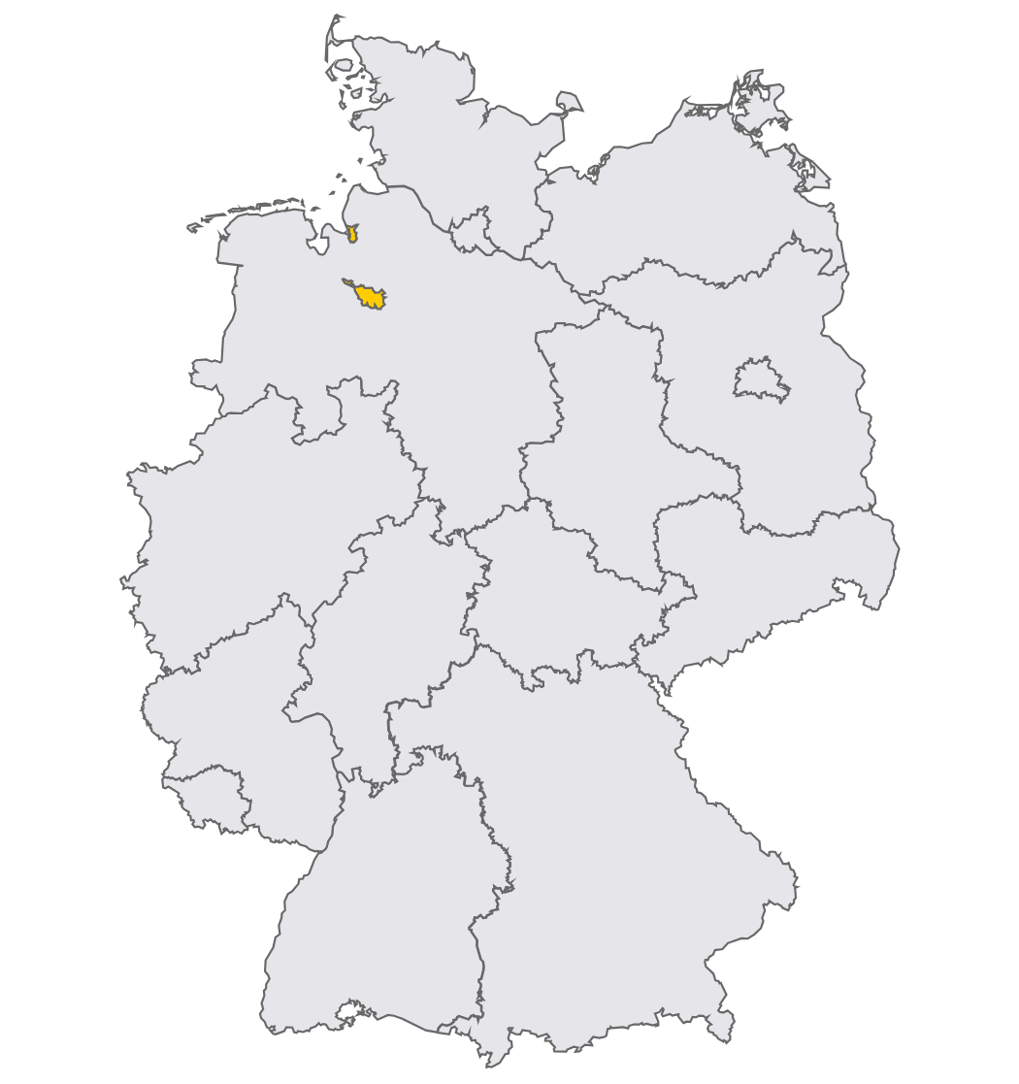
It is more than a multiple-choice test.
The questions touch everyday life and the way Germany's democratic society works.
Democracy
Rights
Society
How institutions and participation work
Equality, freedom and the rule of law
Diversity, family, education and community
History
Everyday life
Your state
Key events and developments in Germany
Living, working and participating in Germany
Questions specific to your Bundesland
This series will focus on understanding first — memorising second.
Leben in Deutschland • Introductory Series
06
ranjigt.github.io/lid-trainer

Slide 7
More than 300,000 people took LiD in 2024.
Official BAMF statistics show the size of the annual test audience.
316,467
290,017
26,450
test participants in 2024
passed in 2024
did not pass in 2024
91.6%
2024 pass rate
≈ 1 in 12 did not pass
This is why preparation still matters.
Source: BAMF, Bundesamt in Zahlen 2024.
Leben in Deutschland • Introductory Series
07
ranjigt.github.io/lid-trainer

Slide 8
THE LONG VIEW
The test audience has changed dramatically over time.
Annual LiD / orientation-test participants, 2009–2024
2009–2024
2.20M
test attempts
91.5%
overall pass rate
The audience is real — and recurring.
Source: BAMF, 2009–2024 table.
08
Leben in Deutschland • Introductory Series
ranjigt.github.io/lid-trainer

Slide 9








THIS YOUTUBE SERIES
What you will get from this series?
Short, visual lessons built around the official question catalogue.
Understand
Learn
Practice
What the question is really asking.
The background and concept behind the answer.
Test yourself with quick quizzes.
Remember
Simulate
Improve
Use repetition, patterns and examples.
Try full 33-question mock exams.
Review mistakes and repeat weak areas.
Languages: English + German • Website practice • YouTube lessons • Open-source project
09
Leben in Deutschland • Introductory Series
ranjigt.github.io/lid-trainer

Slide 10





FROM VIDEO TO PRACTICE
Don't just watch the answer — practise it.
WATCH
THINK
CHECK
REPEAT
PASS
→
→
→
→
YouTube lesson
Choose an answer
Instant feedback
Review mistakes
Build confidence
This is the idea behind my LiD Trainer:
turn passive watching into active learning.
Free to use • no installation • designed for repeated practice
10
Leben in Deutschland • Introductory Series
ranjigt.github.io/lid-trainer

Slide 11
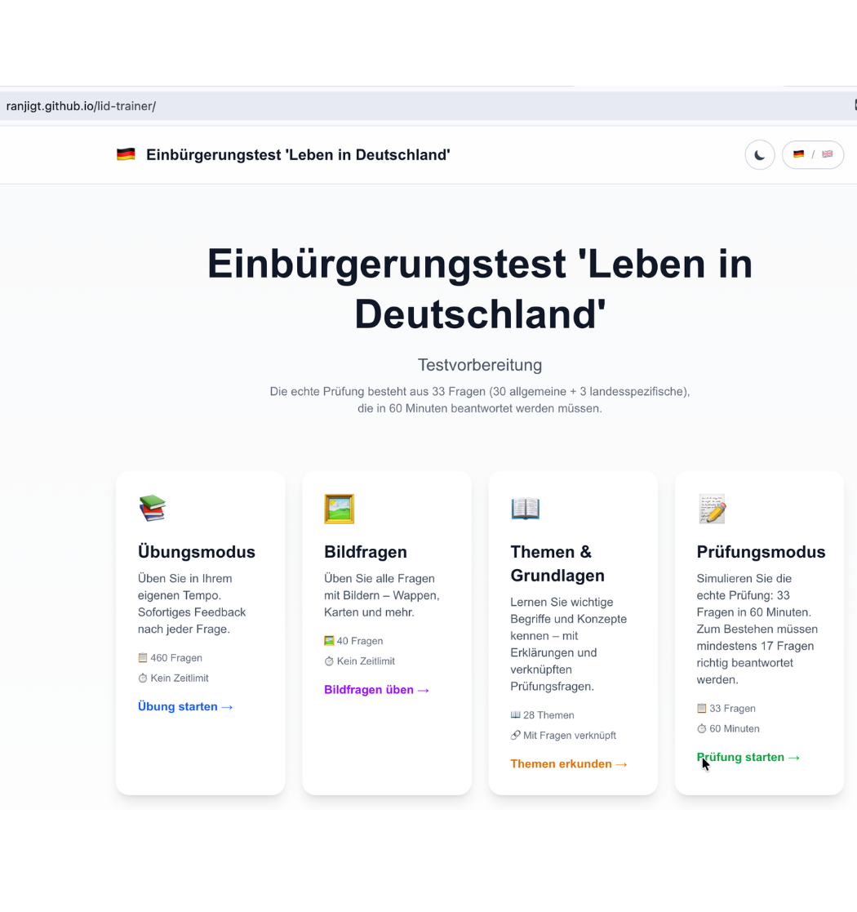
MY PROJECT
Meet the LiD Trainer
A small open-source project I built to make preparation more interactive.
Question bank
Exam mode
Official catalogue structure
33 questions • timed
Feedback
Bilingual
Immediate answers & review
English + German
Open source on GitHub
Leben in Deutschland • Introductory Series
ranjigt.github.io/lid-trainer
11

Slide 12




START LEARNING
12
Ready for Question 1?
Follow the series. Practise on the website. Build your confidence.
1
Watch the lessons
YouTube
2
Practise the questions
LiD Trainer
Scan to practise
ranjigt.github.io/lid-trainer
3
Explore & contribute
GitHub • open source
github.com/ranjiGT/lid-trainer
Thank you for watching • See you in the next lesson
Leben in Deutschland • Introductory Series
ranjigt.github.io/lid-trainer

